Slide 1
Hardware Security
Secure Hardware Computing

Slide 2
Disclaimer
first time
not tested on anyone
not following a course from anywhere
might seem boring - not much pwnage
You don’t like something, something is unclear - tell me

Slide 3
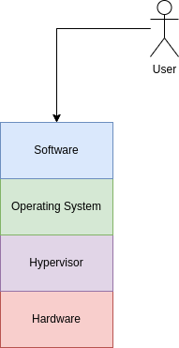
Intro
everything relies on the hardware
break the hardware, you can break everything else
very hard to exploit
very costly to mitigate the exploits

Slide 4
Topics
how can the hardware help us compute stuff
how the hardware guarantee the safety of our data
how can the hardware isolate resources; from users to VMs
some attacks - those that can be replicated

Slide 5
Hardware Computing: Encryption and Decryption
Intel, AMD: AES
ARM: AES, SHA
Other implementations: RISC-V, PowerPC, IBM

Slide 6
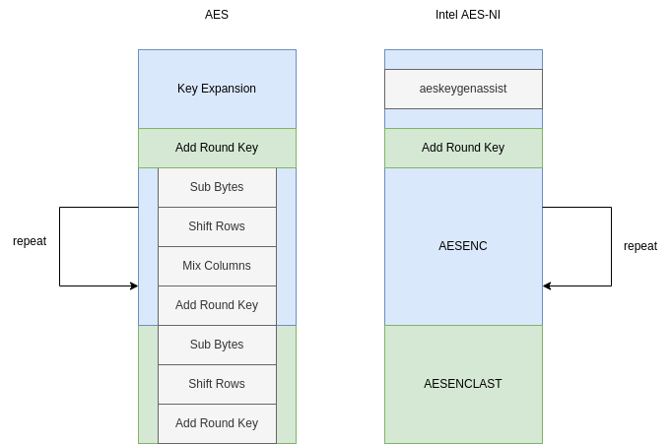
Intel AES-NI
uses SSE2 registers and instructions
no reported attacks
theoretical attack: local side-channel attack

Slide 7
Hardware Computing: Random Numbers
essential for all cryptographic operations
true randomness can’t be achieved
PRNG - pseudo-random number generator
entropy - the quantity of randomness in the system
a normal user can’t generate reliable random numbers
must rely on OS or hardware
OS: /dev/urandom

Slide 8
Intel RDRAND and RDSEED
used to read from Intel’s PRNG
rdrand vs rdseed
rdrand should be faster
rdseed should be impossible to predict - both are impossible to predict
they can (could) be intercepted
CrossTalk, ZombieLoad and Co

Slide 9
CrossTalk - Overview
cross-core staging buffer reading
extremely hard to replicate
not so destructive - you can read some random numbers from another core
very bad for SGX enclaves
mitigated by Intel

Slide 10
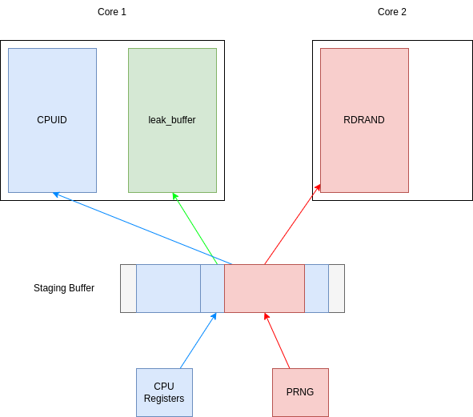
CrossTalk - Theory Behind
one core can read information destined for another core
data is stored in a buffer, before being sent to the core
the buffer isn’t flushed before another core uses it
cpuid - known output, uses the buffer

Slide 11
Trusted Computing
can we trust the machine (the hardware)?
a protocol to ensure the system isn’t altered
implementation: TPM

Slide 12
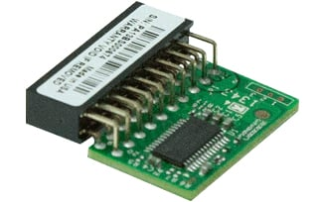
Trusted Platform Module
a hardware chip or implemented in BIOS
stores the initial state of the system, when booting
stores encryption keys or sensitive data
allows access to them if the system isn’t altered by untrusted hardware / software
endorses current system
attests that other systems can be trusted

